Slide 1
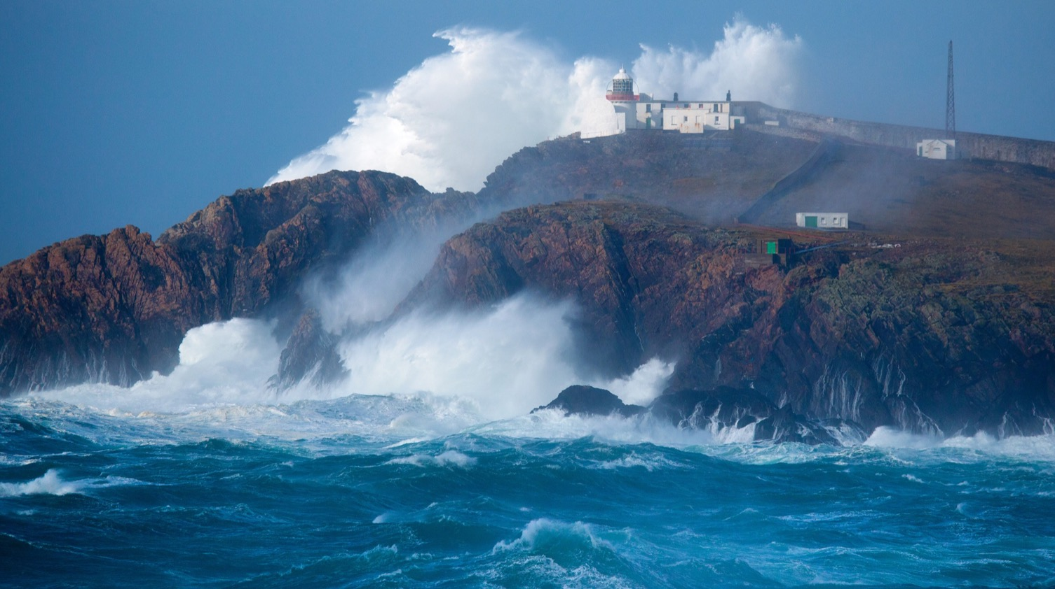


MaREI CENTRE SFI SITE REVIEW
Presentation Title: Application of Expert
Systems to Industrial Optimisation
Presenter Name: Seán Hayes
Platform No: 2

Slide 2
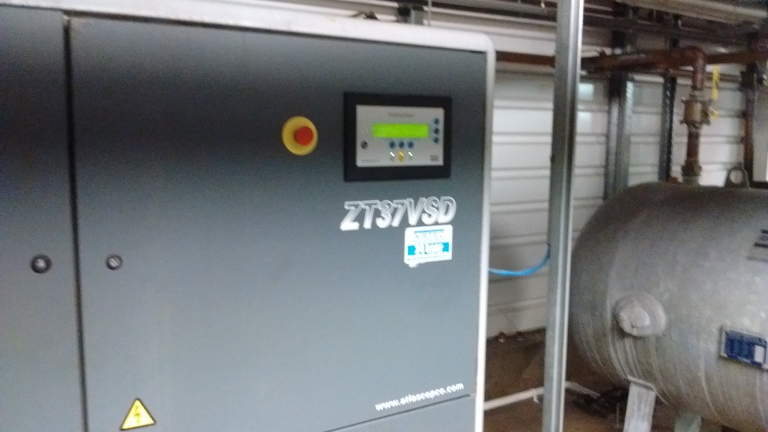
FORMAT OF PRESENTATION
Work completed
Progress against key deliverables
Publications completed and planned
Future activities including time-frame
Notes:
Amend format, text and images as necessary

Slide 3
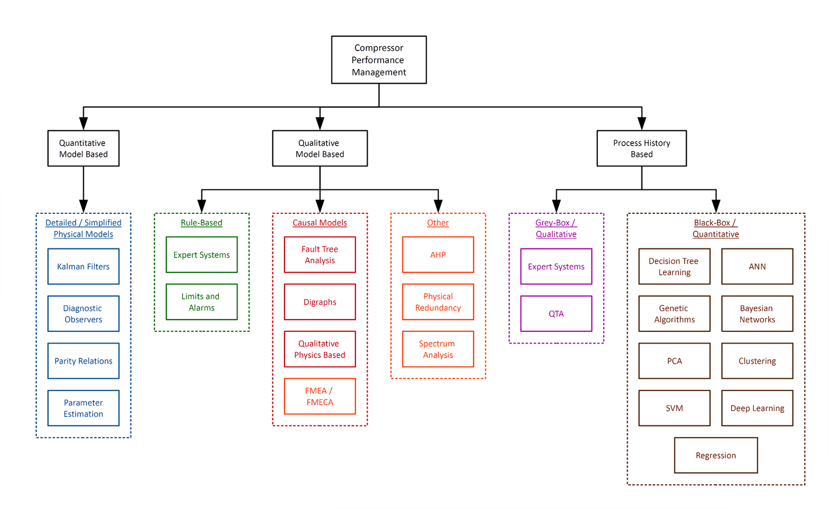

WORK COMPLETED
LITERATURE REVIEW: Comprehensive summary of recent compressor performance management applications
Notes:
Amend format, text and images as necessary

Slide 4
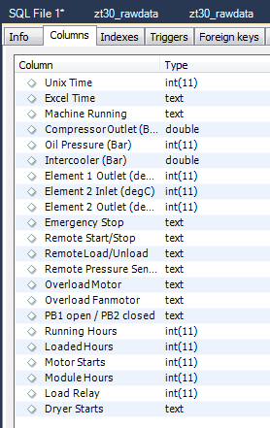
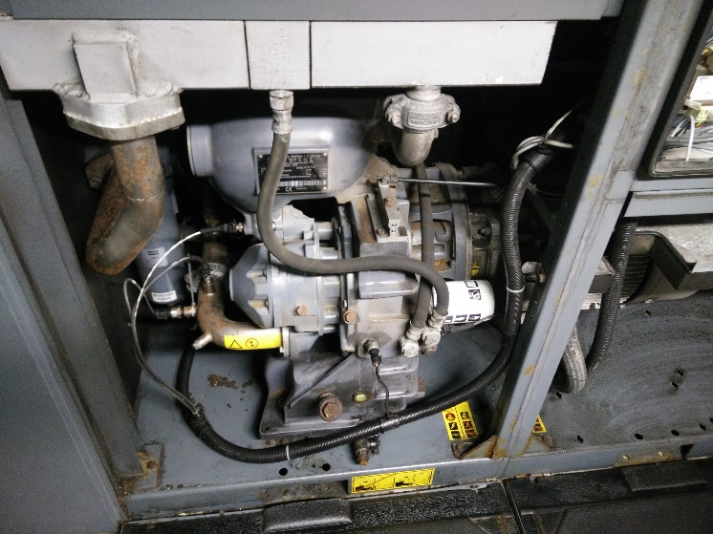
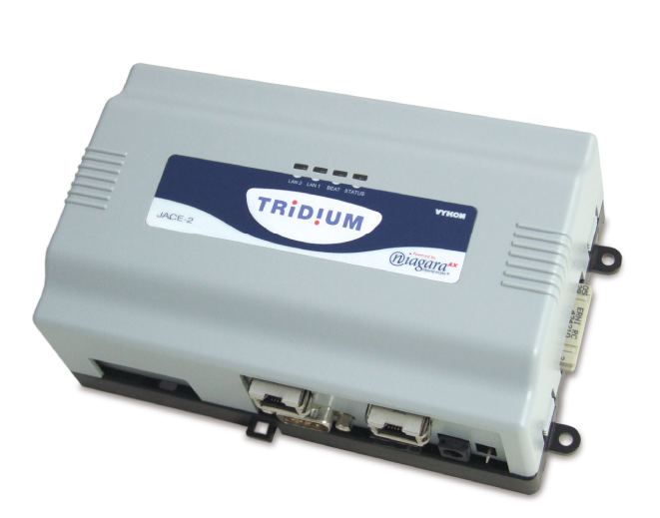
WORK COMPLETED
DATA RETRIEVAL: Automatic data extraction system for test site compressed air system installed
DATA ORGANISATION: Intelligent arrangement of database for ease of analysis
Notes:
Amend format, text and images as necessary

Slide 5
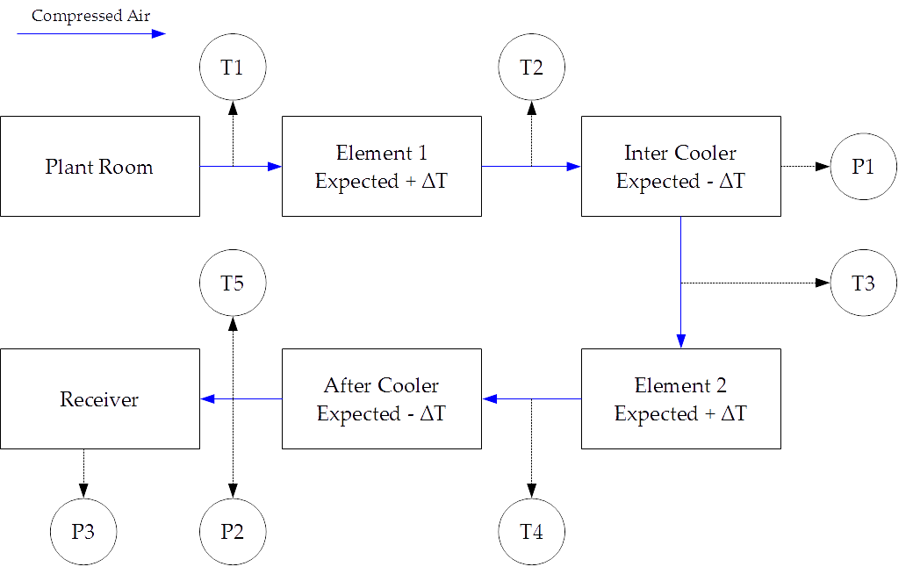
WORK COMPLETED
RULE BASE: Development of a compressor performance assessment rule set to flag ineffective operation
Notes:
Amend format, text and images as necessary

Slide 6
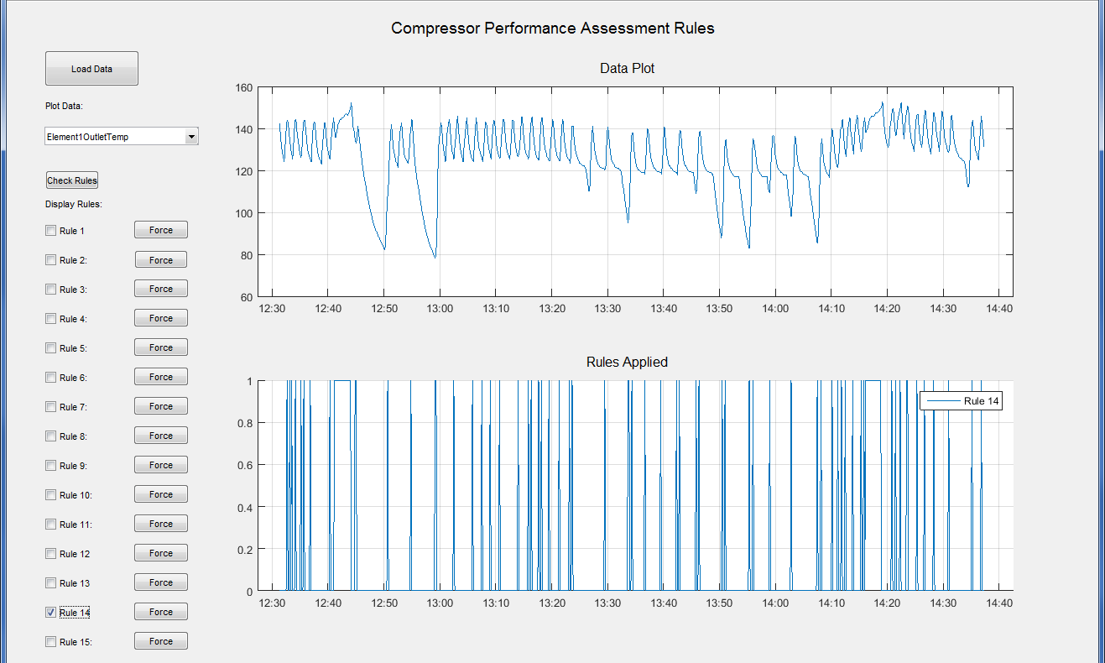
WORK COMPLETED
RULE IMPLEMENTATION: Creation of custom GUI to demonstrate prototype FDD system
Notes:
Amend format, text and images as necessary

Slide 7
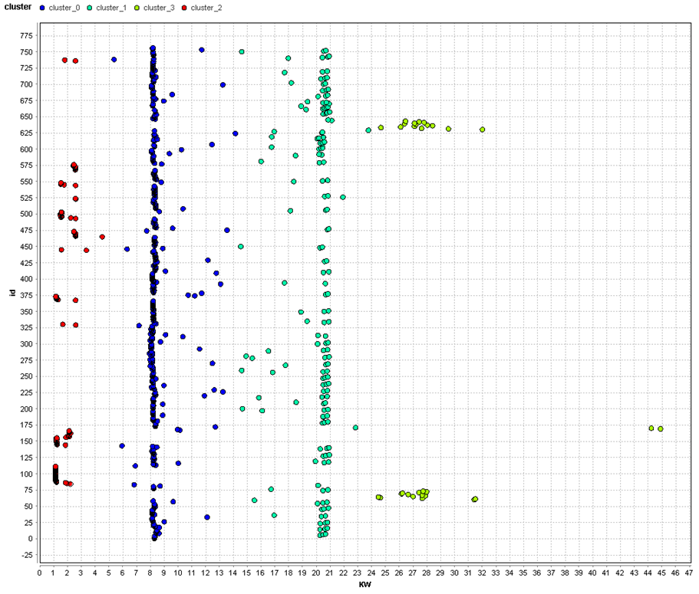
WORK COMPLETED
CLUSTERING: Used 4-means clustering to effectively determine which mode of operation a compressor is in
Cluster | Number of Items | kW Centroid
0 | 463 | 8.38
1 | 164 | 19.93
2 | 100 | 1.72
3 | 30 | 28.60
Notes:
Amend format, text and images as necessary

Slide 8
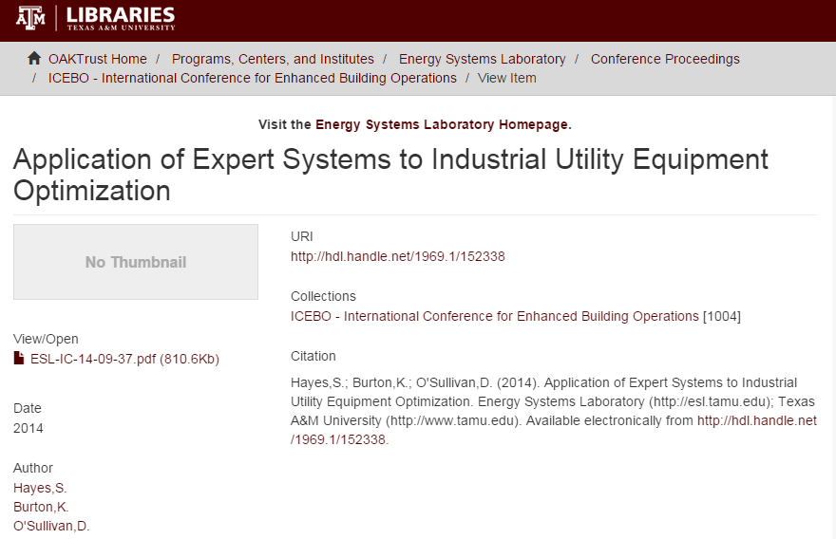
PROGRESS ON DELIVERABLES
D1: CONFERENCE PAPER: Published and presented paper at International Conference for Enhanced Building Operations (ICEBO) 2014
D2: UC BERKELEY: Visited and forged ongoing link with BEST Lab at UC Berkeley - Fall 2014
Notes:
Amend format, text and images as necessary

Slide 9
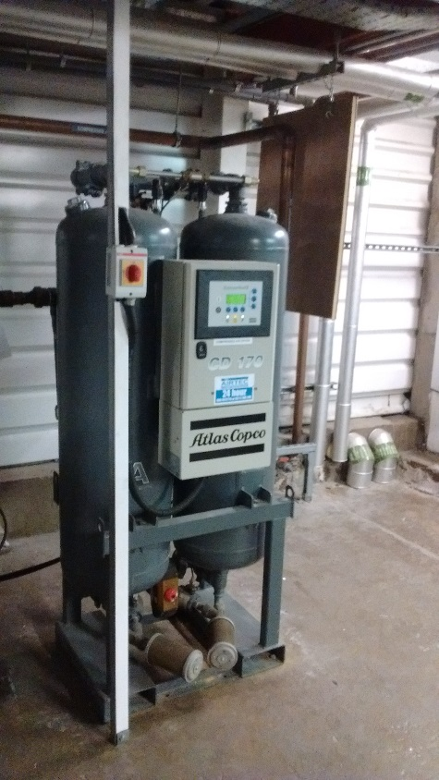

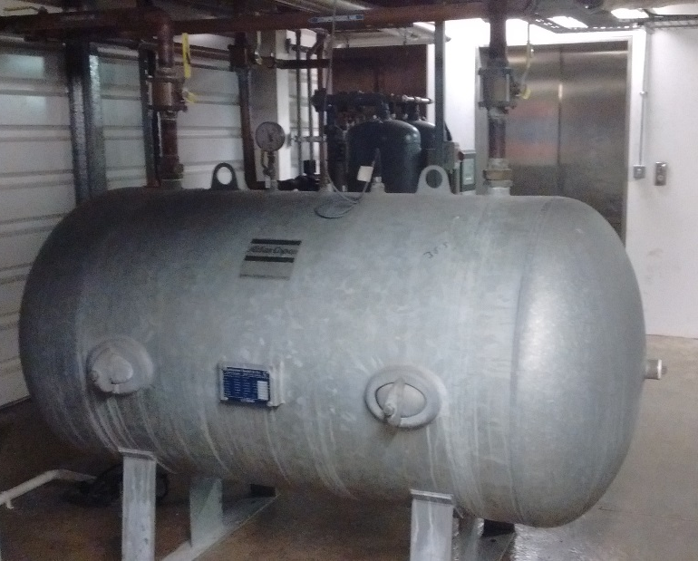
PROGRESS ON DELIVERABLES
D3: TRIAL FDD SYSTEM: Test site identified with historic data analysis and FDD completed. Working toward real-time FDD and optimisation.
D4: PUBLISH JOURNAL PAPER: Results-based paper defined with target submission December 2015
Notes:
Amend format, text and images as necessary

Slide 10
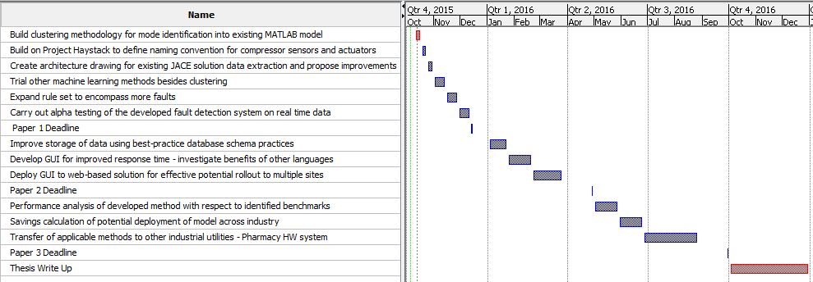
PUBLICATIONS AND FUTURE WORK
CONFERENCE PAPER 1: Submitted
JOURNAL PAPER 1: December 2015
JOURNAL PAPER 2: April 2016
JOURNAL PAPER 3: September 2016
Notes:
Amend format, text and images as necessary

Slide 11











Our Vision:
“Unlocking the potential of our marine and energy resources through the power of innovation”
Notes:
MaREI is an SFI Centre coordinated by the Environmental Research Institute, UCC, with support from SEAI, EI, EPA, ERDF, EU, HEA and IRCSET, as well as through contributions from our industry partners.
Amend logos on funding slide to acknowledge all funders and/or industry partners giving prominence to SFI where applicable
Use strip of academic partner logos as banner at end of slide

Slide 12

www.marei.ie

